Slide 1

Hey! Meet THE TRIBE GROUP MEMBERS: Patrick Atak Marion Ndungu Lilian Wambui Tom Kinyanjui

Slide 2
YouTube
We all have on being on YouTube before and we all know how YouTube videos help in marketing but have your ever thought of when best to upload a video. In this sense, when could my video get the most views! Tribe is a marketing agency that uploads volgues daily on YouTube and seeks to find out when YouTube users are most active on the platform. This way Tribe will know when best to upload a video and ensure it gets the most views, likes, and comments

Slide 3

Hypothesis statement
Null Hypothesis:
Ho =. Videos released over the weekend have greater views on average than the ones released on weekdays.
Alternative Hypothesis:
Ho = There’s no difference in viewership between videos released on weekdays and those released on the weekends.

Slide 4
Research Question
We would like to know when it’s optimum to publish our videos so as to increase our viewership, brand awareness, social engagement and business development.
Metric of success
We measure our success through answering the following questions:
Do we reject our null hypothesis in favour of the alternative.
Which were the common words used in titles of videos that went on to trend.
Is there a correlation between the number of views and the number of likes of trending videos
Approximately how many characters were in the titles of videos that went on to trend.

Slide 5
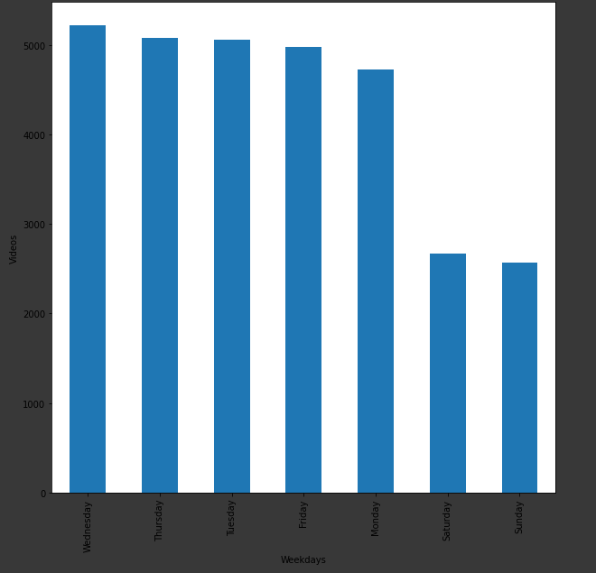
NUMBER OF VIEWS IN RELATION TO DAYS OF THE WEEK
It is evident that during the week we had the list number of views when compared to Wednesday.

Slide 6
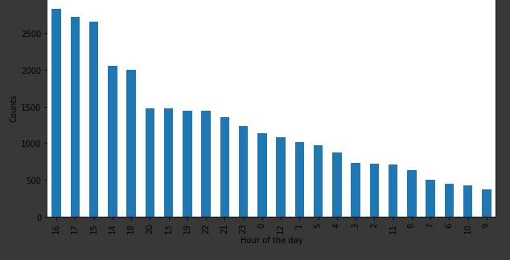
Video Uploads in relation to hour of the day
It is evident that between the 16th and 17th hour YouTube videos were most uploaded

